Slide 1
Forgiveness
Matthew 18:21-35

Slide 2
Forgiveness
SUNDAY SCHOOL OUTLINE
1 - Parable of Debt Forgiveness (Matthew 18:23-35)
2 - The King’s Investment (Exodus 6:2-9)
3 - Contract with Israel to Recognize the LORD as Her Redeemer (Leviticus 25-26)
4 - Israel Chooses a New King and Defaults on Her Gratitude (1 Samuel 8)
5 - The LORD Shows Forgiveness Seventy Times Seven (1 Samuel 8 - 2 Chr. 36)
6 - Delivered to the Tormentors (Daniel 1, 9)
7 - So Likewise… (2 Corinthians 2:10-11)

Slide 3
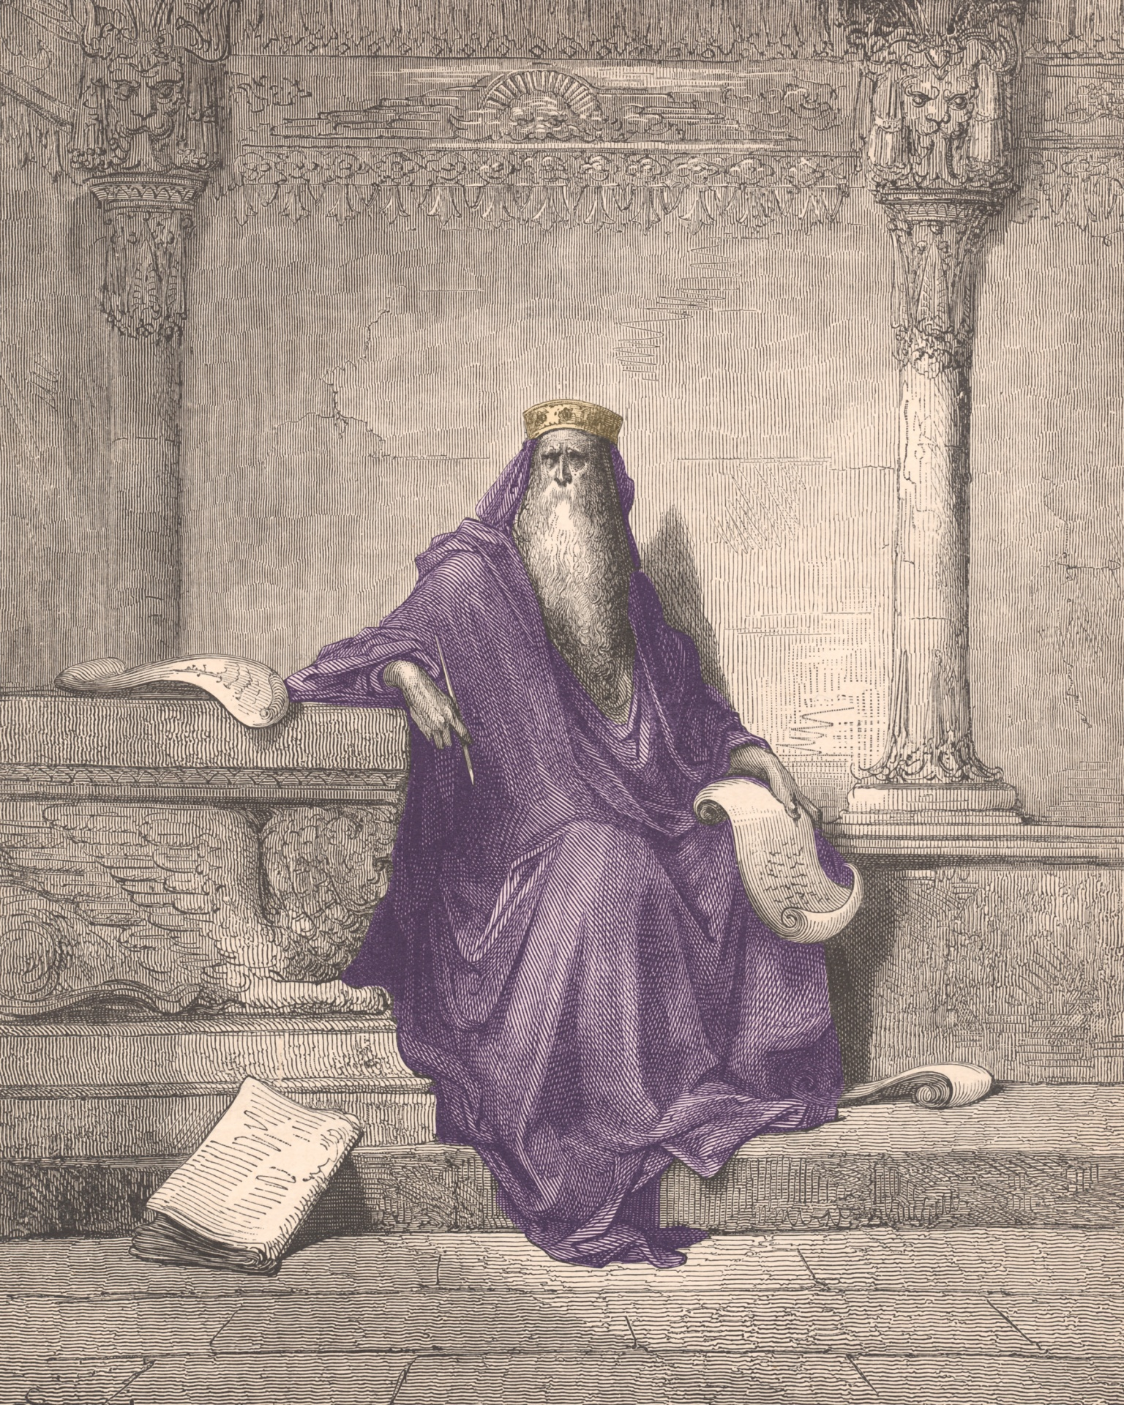
1 - Parable of Debt Forgiveness
Matthew 18:21-35
Kingdom of heaven is like a KING whose servant has very large DEBT that has been FORGIVEN by that king. But that DEBTOR will not FORGIVE a smaller DEBT. The king finds out about the hypocrisy of this servant and decides to exact the original large DEBT from the servant.

Slide 4
2 - The King’s Investment
Exodus 6:2-9
The LORD, like the king in the parable, makes a substantial investment in his servant. The LORD purchases the nation of Israel out of bondage with mighty signs and judgments on Egypt. Finally bringing them through the Red Sea and giving them a fruitful land flowing with milk and honey.

Slide 5
3 - Contract With Israel to Recognize the LORD as Her Redeemer
Leviticus 25-26
In Leviticus 25:1-7, the Lord instructed Israel to give their LAND a REST every 7 years called a Sabbath. In Leviticus 26:1-13 the Lord explains what fruitfulness will be found in obedience. But in Leviticus 26:14 the Lord explains what curses will be found in disobedience.

Slide 6
4 - Israel Chooses a New King and Defaults on Her Gratitude
1 Samuel 8
Beginning with the reign of Saul, Israel rejected her heavenly King and began breaking God’s sabbath rest. Saul put the people and the land under such a tribute that they could no longer afford to quit producing off of their land. (1 Samuel 8:6-17, 10:19, 12:12, 19). That year was 1096 B.C.

Slide 7
5 - The LORD Shows Forgiveness Seventy Times Seven
1 Samuel 8 - 2 Chronicles 36
For the next 490 years, 70 sabbath years would pass while the LORD showed restraint and forgiveness to the nation of Israel. He would send them prophets, give them good kings, bless them when they sought Him out, and protect them when they cried for help. The LORD would do all this while the nation failed to let the land rest because they chose their money and businesses over God.

Slide 8
6 - Delivered to the Tormentors
Daniel 1, 9
After 490 years, 70 sabbath years of rest have been ignored, the LORD delivers the nation into the hands of the Gentiles. Saul became king as Israel officially rejected her King in 1096 B.C. In 606 B.C. Nebuchadnezzar attacks Jerusalem, the capital city of the nation, kills thousands and violently removes the Jews from their land. This is what the king does in the parable who delivers his servant to the tormentors. Daniel understands that the debt will have to be paid back, 70 weeks determined upon thy people.

Slide 9
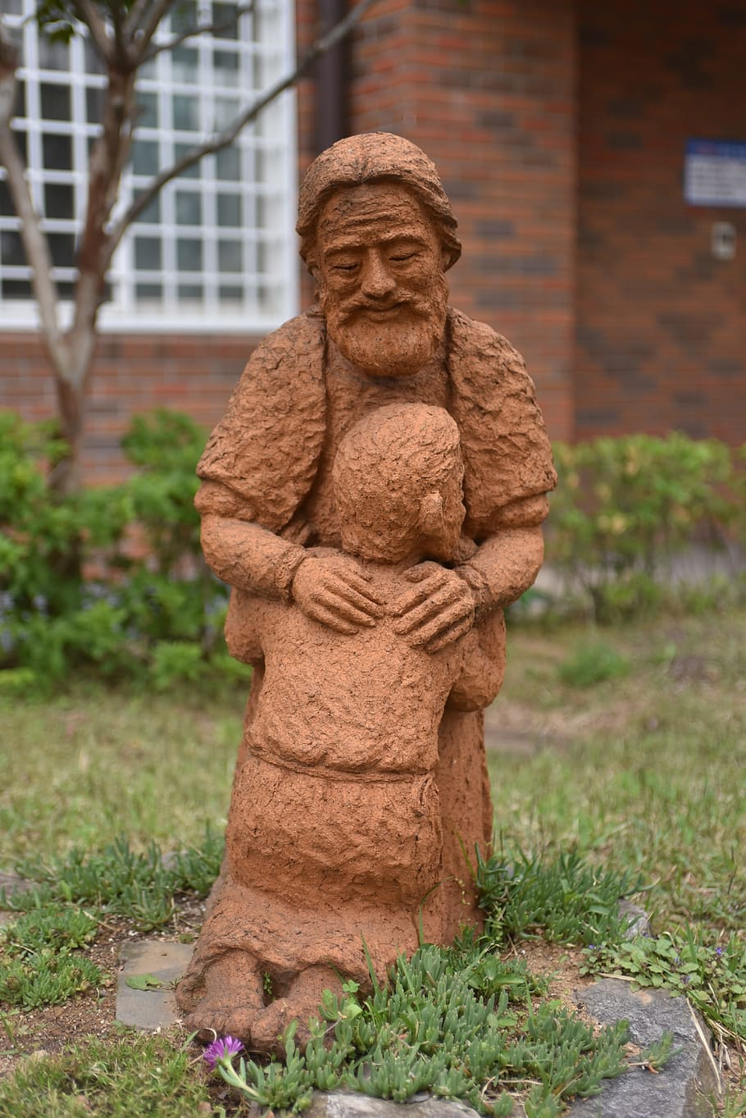
7 - So Likewise...
2 Corinthians 2:10-11
The LORD is the king. If you’ve been forgiven through the blood of the LORD Jesus Christ, but you choose to hold a grudge against someone who has offended you far less than you’ve offended God, and that person has sought out your forgiveness as he says in Luke 17:3-4, then you are a hypocrite to continue holding it against them. At that point, Satan will have the advantage in your life. You’ll be turned over to the tormentors so to speak like the servant in the parable, like Israel as a nation.

